Slide 1
Innovation Policy for Human Capital Investment in Taiwan’s Education
Chuing Prudence Chou 周祝瑛
Department of Education
National Chengchi University (NCCU), Taiwan
International Strategic Research Congress (ISRC 2019)

Slide 2
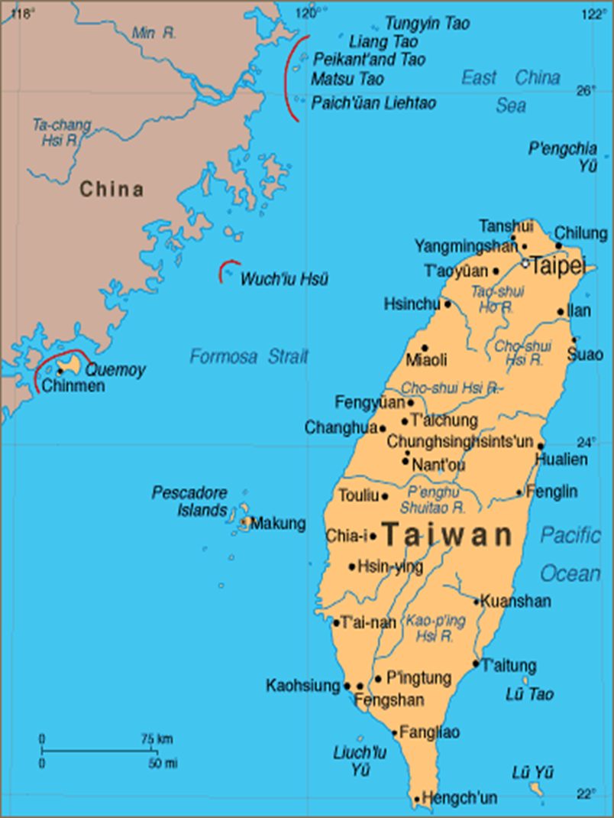

Slide 3
Profile of Taiwan
Area :36,000 square kilometers
Population: 23.6 million (2018)
Capital : Taipei City
Languages : Mandarin/Taiwanese (Hokkien)/Hakka/Indigenous Languages
Number of HEIs: 157 universities, colleges, and junior colleges
Notes:
Higher education institutions in Taiwan include 2-year junior colleges, 5-year junior colleges, and universities. Like most countries, the study period is 4 years for an undergraduate university degree, 1 to a maximum of 4 years for a master degree, and 2 to a maximum of 7 years for a doctoral degree.
In SY2017, there are 157 universities, colleges and junior colleges, totaling 1,273,894 students.
Higher technological and vocational education in Taiwan is divided into junior colleges (2-year and 5-year), technical colleges and universities of science and technology as follows:
Junior colleges are divided into two categories depending on the duration of their curriculum, two years or five years. The two-year schools recruit students from skill-based senior secondary schools, comprehensive senior secondary schools graduates or with the same education level. The five-year schools are attended by junior high school graduates or students with qualifications of the same level. Graduates from the schools receive an associate degree.

Slide 4
Background
Declining birth rate: Total Fertility Rate (TFR) of 1.06 children per woman (2018)
  World Health Organization: 2.1 children per woman -> Replacement-level fertility
Aged society as of this year: 14.05% of population over 65 years of age
2015: Humanities and Social Sciences 58% / STEM 42%

Slide 5
Research Questions
What institutions and programs exist to promote STEM education, TVET, and human capital development in Taiwan?
What key challenges do these initiatives try to address?
How successful have these initiatives been at promoting human capital development?
Notes:
Science, Technology, Engineering, and Mathematics education (STEM)
Technical and Vocational Education and Training (TVET)

Slide 6
Methodology
Government document analysis of government education reports, data, and white papers (Ministry of Education)
Interpretation of educational reform policies
Government education policy analysis
Media analysis of impact of policies (data & interviews)

Slide 7
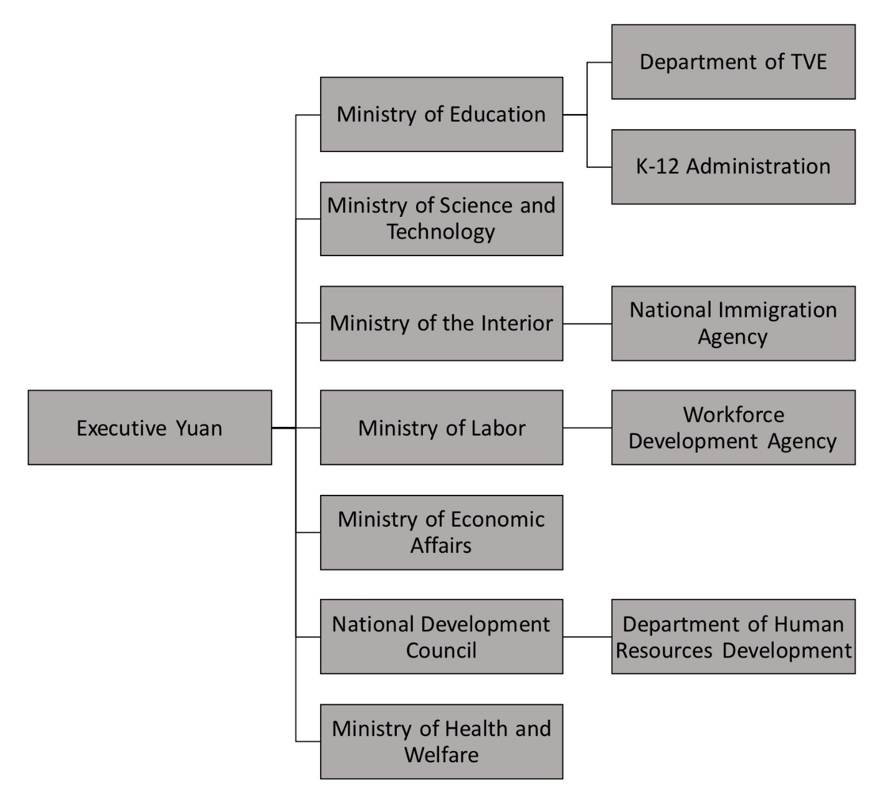
Research Findings
Figure 1: Agencies and institutions involved in human capital development
Source: Adapted from Executive Yuan (2016)
Notes:
In response to Research Question 1

Slide 8
Private Investment & Domestic/Foreign Enterprises
Household spending on education among the world’s highest
Average of US$56,424 spent on every Taiwanese child
Private primary and secondary school tuition and fees, after-school programs (buxiban 補習班), and college expenses
Greater number of domestic enterprises funding employee training
Google, Microsoft, and Amazon among largest foreign enterprises investing in human capital development
Notes:
In response to Research Question 1
Google: Taiwan is its largest R&D center in Asia. Committing in 2018 to “train 50,000 Taiwanese businesses and students in digital marketing over the next year through a combination of online and offline initiatives” and “holding a train-the-trainers program for teachers in locations across Taiwan … to educate a new generation of Taiwanese students in AI” and machine learning.
Microsoft: Launched AI R&D Center
Amazon: Invested in “Joint Innovative Center”

Slide 9
Key Challenges
STEM in high demand, especially from schools and parents
STEM associated with higher wages and job opportunities
TVET regarded as a secondary choice -> Diluted
Massification of HE
Less vocational skilled workers produced; students desire HE more
Less funding allocated for vocational, TVET training
Stagnant wages and surplus of college graduates leads talent to look overseas for opportunities
Competitive economic pull factors from abroad
Greater policy focus on service industry -> Increase in Humanities & Social Science
Notes:
In response to Question 2

Slide 10
Local Responses
As of 2016, public expenditure per student is at its highest level
STEM programs produced many graduates -> Many graduates seek opportunities abroad
Brain Drain effect, particularly from Taiwan to China
Shift away from TVET -> Firms lack vocationally trained labor
National Science and Technology Development Plan
Taiwan Productivity 4.0 Initiative
Greater collaboration between educational institutions
Notes:
In response to Question 3

Slide 11
The 1994 Educational Reform Master Plan was launched to increase the number of general high schools and universities
-- to accommodate the greater societal need for schooling.
-- to relieve high school and university entrance examination competition and pressure.

Slide 12
Conclusion
Government, businesses, individuals must collaborate to address rising international competition
Greater innovation and productivity needed to guarantee prosperity and equity in Taiwan
Reemphasize the importance of TVET alongside STEM in relation to human capital development

Slide 13

Chuing Prudence Chou周祝瑛
Email: iaezcpc@nccu.edu.tw
Website: http://www3.nccu.edu.tw/~iaezcpc/en/

Slide 14
Thank you
Teşekkür ederim
謝謝

